Slide 1
XG Boosting Algorithm

Slide 2
What is XGBoost Regressor?
XGBoost Regressor is a type of supervised machine learning algorithm used for making predictions on continuous numerical data, specifically for regression tasks. It's an implementation of the gradient boosting algorithm, an ensemble learning method that combines predictions from multiple weaker models to create a stronger, more accurate model. XGBoost is known for its efficiency, scalability, and ability to handle large datasets, making it popular for various regression problems.

Slide 3
sklearn.ensemble.GradientBoostingRegressor
class sklearn.ensemble.GradientBoostingRegressor(*, loss='squared_error', learning_rate=0.1, n_estimators=100, subsample=1.0, criterion='friedman_mse', min_samples_split=2, min_samples_leaf=1, min_weight_fraction_leaf=0.0, max_depth=3, min_impurity_decrease=0.0, init=None, random_state=None, max_features=None, alpha=0.9, verbose=0, max_leaf_nodes=None, warm_start=False, validation_fraction=0.1, n_iter_no_change=None, tol=0.0001, ccp_alpha=0.0)[source]
This class implements the algorithm know as XGBoost.

Slide 4
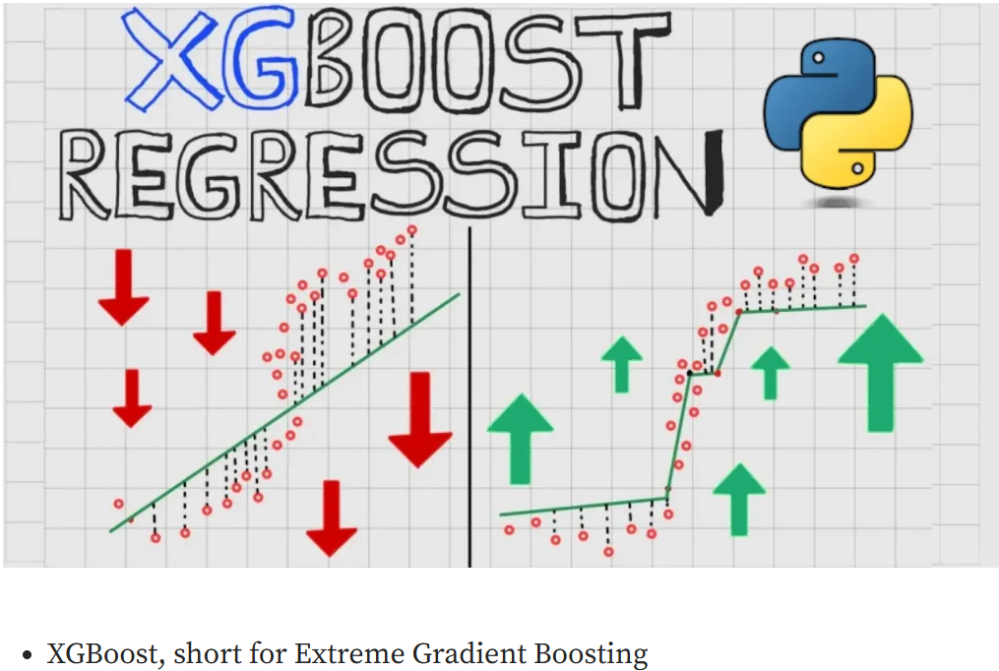

Slide 5
Advantages of XGBoost Algorithm
XGBoost is highly scalable and efficient as It is designed to handle large datasets with millions or even billions of instances and features.
XGBoost implements parallel processing techniques and utilizes hardware optimization, such as GPU acceleration, to speed up the training process. This scalability and efficiency make XGBoost suitable for big data applications and real-time predictions.
It provides a wide range of customizable parameters and regularization techniques, allowing users to fine-tune the model according to their specific needs.
XGBoost offers built-in feature importance analysis, which helps identify the most influential features in the dataset. This information can be valuable for feature selection, dimensionality reduction, and gaining insights into the underlying data patterns.
XGBoost has not only demonstrated exceptional performance but has also become a go-to tool for data scientists and machine learning practitioners across various languages. It has consistently outperformed other algorithms in Kaggle competitions, showcasing its effectiveness in producing high-quality predictive models.

Slide 6
Disadvantages of XGBoost Algorithm
XGBoost can be computationally intensive especially when training complex models making it less suitable for resource-constrained systems.
Despite its robustness, XGBoost can still be sensitive to noisy data or outliers, necessitating careful data preprocessing for optimal performance.
XGBoost is prone to overfitting on small datasets or when too many trees are used in the model.
While feature importance scores are available, the overall model can be challenging to interpret compared to simpler methods like linear regression or decision trees. This lack of transparency may be a drawback in fields like healthcare or finance where interpretability is critical.

Slide 7
Thank you

